Slide 1
SPARK Architecture
Devi Ramasamy

Slide 2
What is SPARK?
Apache Spark is an open source parallel processing framework for data processing .
The main feature of Apache Spark is its in-memory cluster computing that increases the processing speed of an application.
Spark provides an interface for programming entire clusters with implicit data parallelism and fault tolerance.
It is designed to cover a wide range of workloads such as batch applications, iterative algorithms, interactive queries, and streaming.

Slide 3
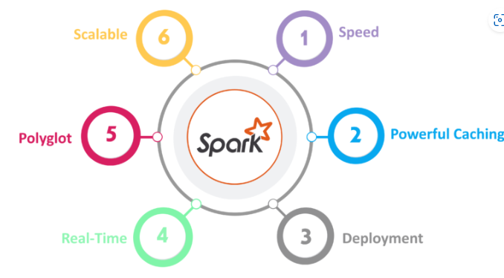
Features of SPARK

Slide 4
Features of SPARK
Speed
Spark runs up to 100 times faster than Hadoop MapReduce for large-scale data processing. It is also able to achieve this speed through controlled partitioning.
Powerful Caching
Simple programming layer provides powerful caching and disk persistence capabilities.
Deployment
It can be deployed through Mesos, Hadoop via YARN, or Spark’s own cluster manager.
Real-Time
It offers Real-time computation & low latency because of in-memory computation.

Slide 5
Polyglot
Spark provides high-level APIs in Java, Scala, Python, and R. Spark code can be written in any of these four languages. It also provides a shell in Scala and Python.
Scalability
Apache Spark is a powerful distributed computing framework that is designed to handle large-scale data processing tasks. One of the key features of Spark is its ability to scale up or down based on the size of the data and the processing requirements.

Slide 6
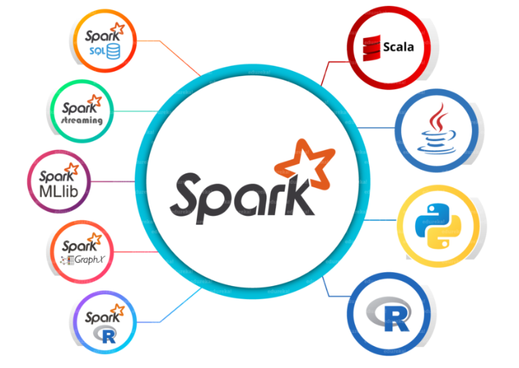
Spark Eco-System
The spark ecosystem is composed of various components like Spark SQL, Spark Streaming, MLlib, GraphX, and the Core API component.

Slide 7
SparkCore
Spark Core is the base engine for large-scale parallel and distributed data processing. It is responsible for memory management and fault recovery, scheduling, distributing and monitoring jobs on a cluster & interacting with storage systems.
Spark Streaming
Spark Streaming is the component of Spark which is used to process real-time streaming data. It enables high-throughput and fault-tolerant stream processing of live data streams. Spark SQL will be an easy transition from your earlier tools where you can extend the boundaries of traditional relational data processing.
Spark SQL
Spark SQL is a new module in Spark which integrates relational processing with Spark’s functional programming API.
GraphX
GraphX is the Spark API for graphs and graph-parallel computation. Thus, it extends the Spark RDD with a Resilient Distributed Property Graph.
MLlib (Machine Learning)
MLlib stands for Machine Learning Library. Spark MLlib is used to perform machine learning in Apache Spark.
SparkR
It is an R package that provides a distributed data frame implementation. It also supports operations like selection, filtering, aggregation but on large data-sets.

Slide 8
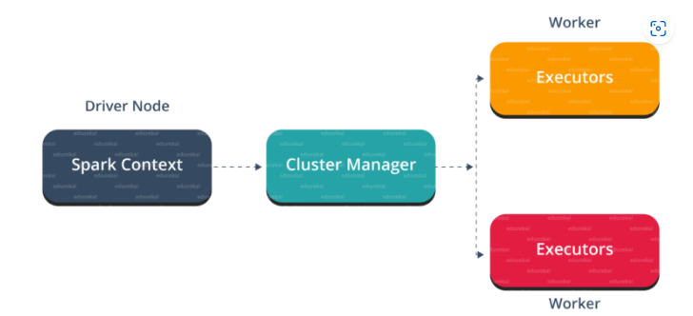
SPARK Architecture Overview
Apache Spark has a well-defined layered architecture where all the spark components and layers are loosely coupled. This architecture is further integrated with various extensions and libraries. Apache Spark Architecture is based on two main abstractions:
Resilient Distributed Dataset (RDD)
Directed Acyclic Graph (DAG)

Slide 9
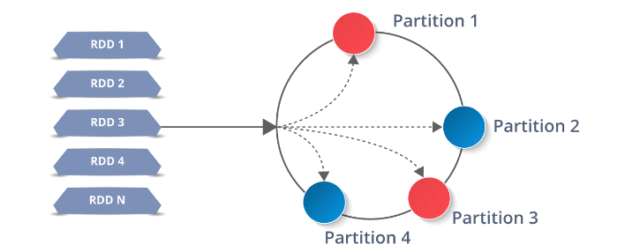
Resilient Distributed Dataset(RDD)
RDDs are the fundamental data structure any Spark application. RDDs Stands for:
Resilient: Fault tolerant and is capable of rebuilding data on failure
Distributed: Distributed data among the multiple nodes in a cluster
Dataset: Collection of partitioned data with values

Slide 10
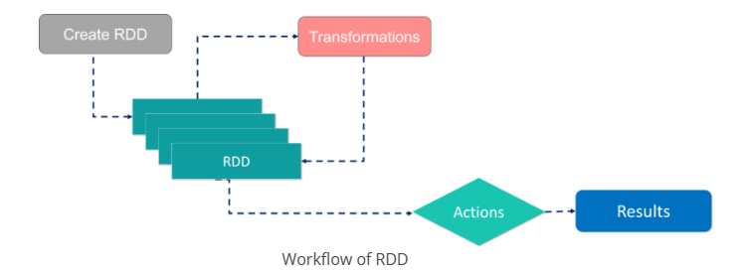
RDDs are an immutable collection of objects that can be processed in parallel across a cluster of machines in a fault-tolerant way. RDDs provide a simple, high-level programming interface to distribute data across multiple machines, process it in parallel, and return the results to the user. There are two ways to create RDDs − parallelizing an existing collection in your driver program, or by referencing a dataset in an external storage system, such as a shared file system, HDFS, HBase, etc.
With RDDs, you can perform two types of operations:
Transformations: They are the operations that are applied to create a new RDD.
Actions: They are applied on an RDD to instruct Apache Spark to apply computation and pass the result back to the driver.

Slide 11
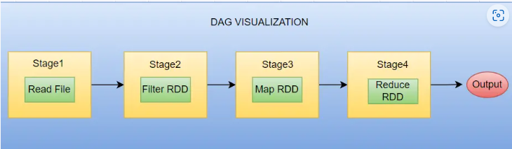
Directed Acyclic Graph (DAG)
DAG (Directed Acyclic Graph) in Spark/PySpark is a fundamental concept that plays a crucial role in the Spark execution model. The DAG is “directed” because the operations are executed in a specific order, and “acyclic” because there are no loops or cycles in the execution plan. This means that each stage depends on the completion of the previous stage, and each task within a stage can run independently of the other.

Slide 12
At a high level, a DAG represents the logical execution plan of a Spark job. When a Spark application is submitted, Spark translates the high-level operations (such as transformations and actions) specified in the application code into a DAG of stages and tasks.
Spark achieves fault tolerance using the DAG by using a technique called lineage, which is the record of the transformations that were used to create an RDD. When a partition of an RDD is lost due to a node failure, Spark can use the lineage to rebuild the lost partition.

Slide 13
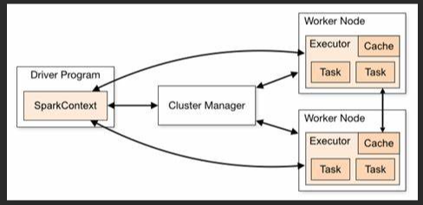
Working of Spark Architecture

Slide 14
In your master node, you have the driver program, which drives your application. The code you are writing behaves as a driver program. Inside the driver program, the first thing you do is, you create a Spark Context.
Now, this Spark context works with the cluster manager to manage various jobs. The driver program & Spark context takes care of the job execution within the cluster. A job is split into multiple tasks which are distributed over the worker node.
Worker nodes are the slave nodes whose job is to basically execute the tasks. These tasks are then executed on the partitioned RDDs in the worker node and hence returns back the result to the Spark Context.

Slide 15
STEP 1: The client submits spark user application code. When an application code is submitted, the driver implicitly converts user code that contains transformations and actions into a logically directed acyclic graph called DAG. At this stage, it also performs optimizations such as pipelining transformations.
STEP 2: After that, it converts the logical graph called DAG into physical execution plan with many stages. After converting into a physical execution plan, it creates physical execution units called tasks under each stage. Then the tasks are bundled and sent to the cluster.
STEP 3: Now the driver talks to the cluster manager and negotiates the resources. Cluster manager launches executors in worker nodes on behalf of the driver. At this point, the driver will send the tasks to the executors based on data placement. When executors start, they register themselves with drivers. So, the driver will have a complete view of executors that are executing the task.
STEP 4: During the course of execution of tasks, driver program will monitor the set of executors that runs. Driver node also schedules future tasks based on data placement.

Slide 16


Slide 17


